Slide 1
And the points go to…
Schulze 9/29/2020

Slide 2
What did I add?
Coding for generating a histogram of the forecasts for the week and the average plotted to give us an idea of the spread in forecasts.
Code to randomly pick the bonus point earners in case you don’t want to do it yourself.

Slide 3
Histogram code
# Add Histogram of results, plots each student's guess, and the actual mean value for
# week one.
plt.hist(forecasts1,bins=120,color = 'blue', alpha=0.75, label = 'Student Guesses')
plt.plot([obs_week]*3, np.arange(0,3,1),color='orange',linestyle= '-',label = 'Actual mean')
plt.title('Student Guesses and actual mean, week 1')
plt.xlabel('Flow Forecast')
plt.ylabel('Count')
plt.legend(loc = 'upper right')

Slide 4
Random chooser code
if random_flag:
firstnames=np.array(['Ty', 'Lourdes', 'Diana', 'Quinn’, 'Abigail', 'Alcely', 'Richard','Alexa', 'Xenia', 'Ben', 'Shweta','Patrick', 'Jill', 'Mekha', 'Jake', 'Camilo’ , 'Scott’ , 'Adam’ , 'Danielle'])
selection = random.sample(range(0,18), 3) # Selects 3 indicies from an array the lenght of our classlist
bonus_names = firstnames[selection] # Takes the place of the bonus_names call in the block below
#print(selection) # Used to verify the selection did not duplicate
# Visually verifies the selection being made from the array above
print(bonus_names)

Slide 5
Results
Observed flow: 58.429 cfs
Closest: 59 cfs - Patrick
2nd: 60cfs - Adam
3rd: 56.39cfs - Camilo
2 week forecast winners: Closest: 57.5 – Lourdes
2nd: 57 – Jill
3rd: 56.5 - Mekha

Slide 6
Bonus points
Can’t be Patrick, Adam, Camilo, Lourdes, Jill, or Mekha. Scott because he made the system and did not want to be accused of any funny business.
Therefore, by random choice: Richard, Abigail, and Diana.
Congratulations!

Slide 7
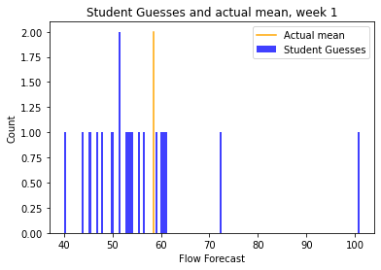
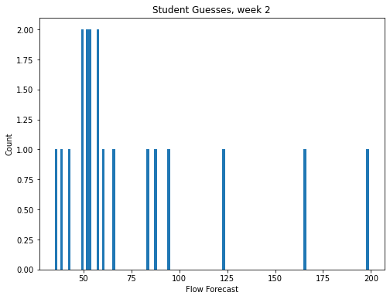
Results for the week, visually

Slide 8
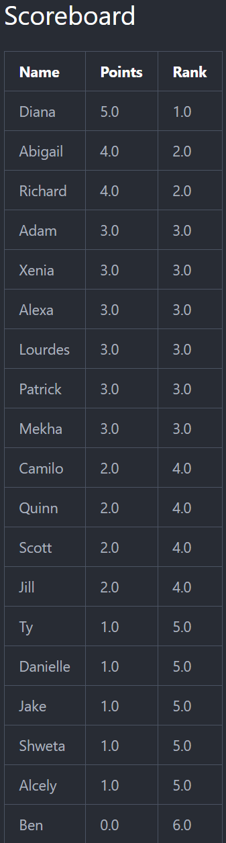
Scoreboard

Slide 9

Richard has next week’s. On with today’s class!

